Slide 1
MERGE SORT AND SEARCHING ALGORITHMS
KIRUTHIKA K
1831029

Slide 2
MERGE SORT
Merge Sort follows the rule of Divide and Conquer to sort a given set of numbers/elements.
In Merge Sort, the given unsorted array with n elements, is divided into n subarrays, each having one element. Then, it repeatedly merges these subarrays, to produce new sorted subarrays, and in the end, one complete sorted array is produced.

Slide 3
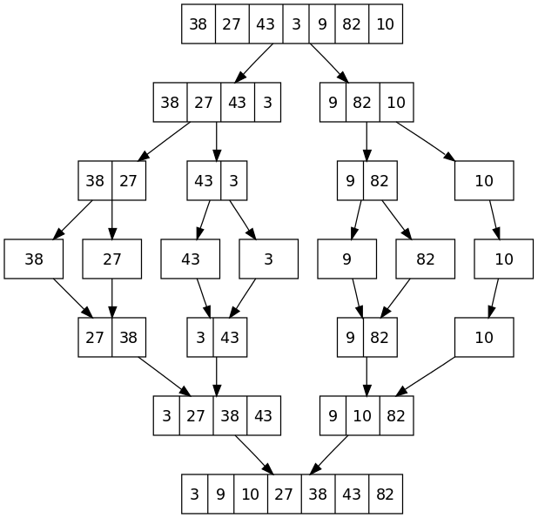

Slide 4
COMPLEXITY
TIME COMPLEXITY: O(n*log n)
SPACE COMPLEXITY: O(n)

Slide 5
SEARCHING
Searching Algorithms are designed to check for an element or retrieve an element from any data structure where it is stored.
Based on the type of search operation, these algorithms are generally classified into two categories:
Sequential Search
Interval Search

Slide 6
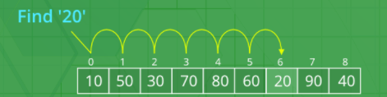
LINEAR SEARCH
A linear search or sequential search sequentially checks each element of the list until a match is found or the whole list has been searched.
TIME COMPLEXITY
BEST CASE - O(1)
AVERAGE and WORST CASE - O(n)

Slide 7
BINARY SEARCH
This search algorithm works on the principle of divide and conquer.
Search a sorted array by repeatedly dividing the search interval in half.
Binary search looks for a particular item by comparing the middle most item of the collection. If a match occurs, then the index of item is returned. If the middle item is greater than the item, then the item is searched in the sub-array to the left of the middle item. Otherwise, the item is searched for in the sub-array to the right of the middle item. This process continues on the sub-array as well until the size of the subarray reduces to zero.
mid = low + (high - low) / 2

Slide 8
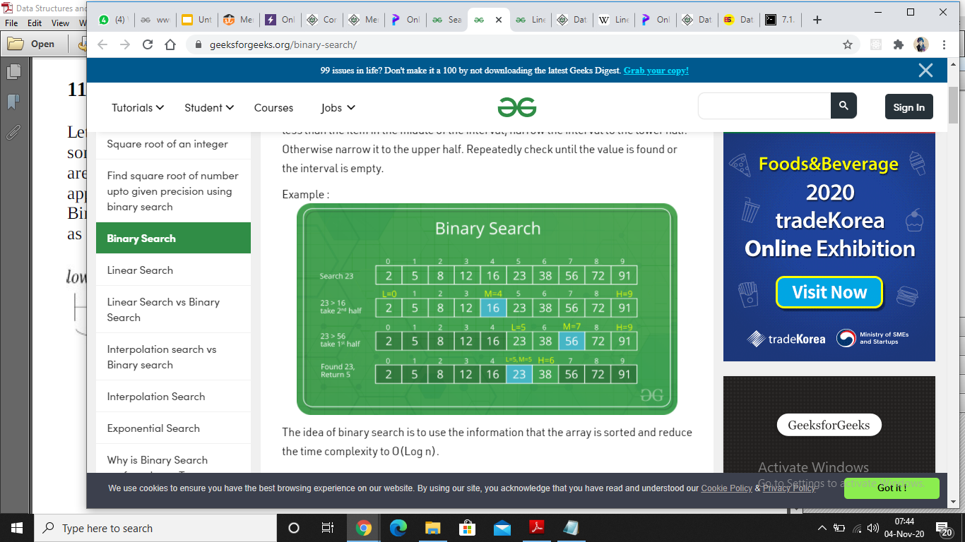
TIME COMPLEXITY
BEST CASE - O(1)
AVERAGE and WORST CASE - O(log n)

